Slide 1

COMP 499/691: Conversational Artificial Intelligence
Recurrent Neural Networks
Computer Science & Software Engineering
Concordia University, Winter 2024

Slide 2
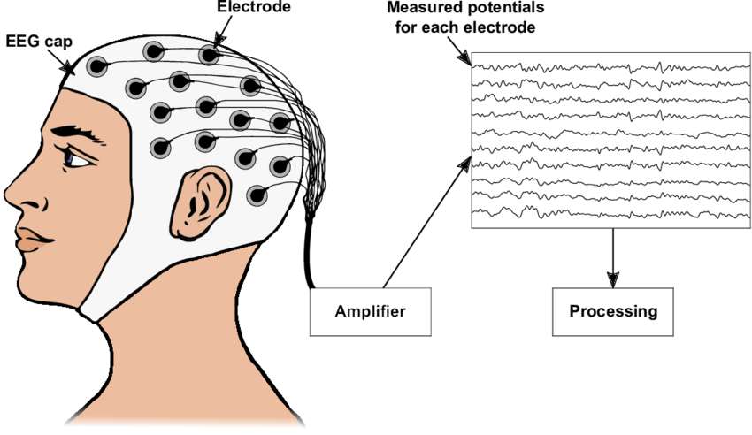

Seminar Announcement
Dr. Davide Borra (University of Bologna) will be give three seminar lectures focusing on deep learning for EEG signal processing.
Date | Room | Lecture topics
Feb., 16 9 am - 11 am | Remote | Introduction to EEG and EEG decoding
Feb., 23 9 am - 11 am | Remote | EEG Decoding with SpeechBrain
March, 15 9 am - 11 am | Remote | Decoding speech from the EEG

Slide 3
Summary of the last episode….
What we have seen last time:
Basic Concepts for Neural Networks (vanishing gradient, normalization, regularization)
Convolutional Neural Networks
What we are going to learn today:
Recurrent Neural Networks

Slide 4
Recurrent Neural Networks

Slide 5
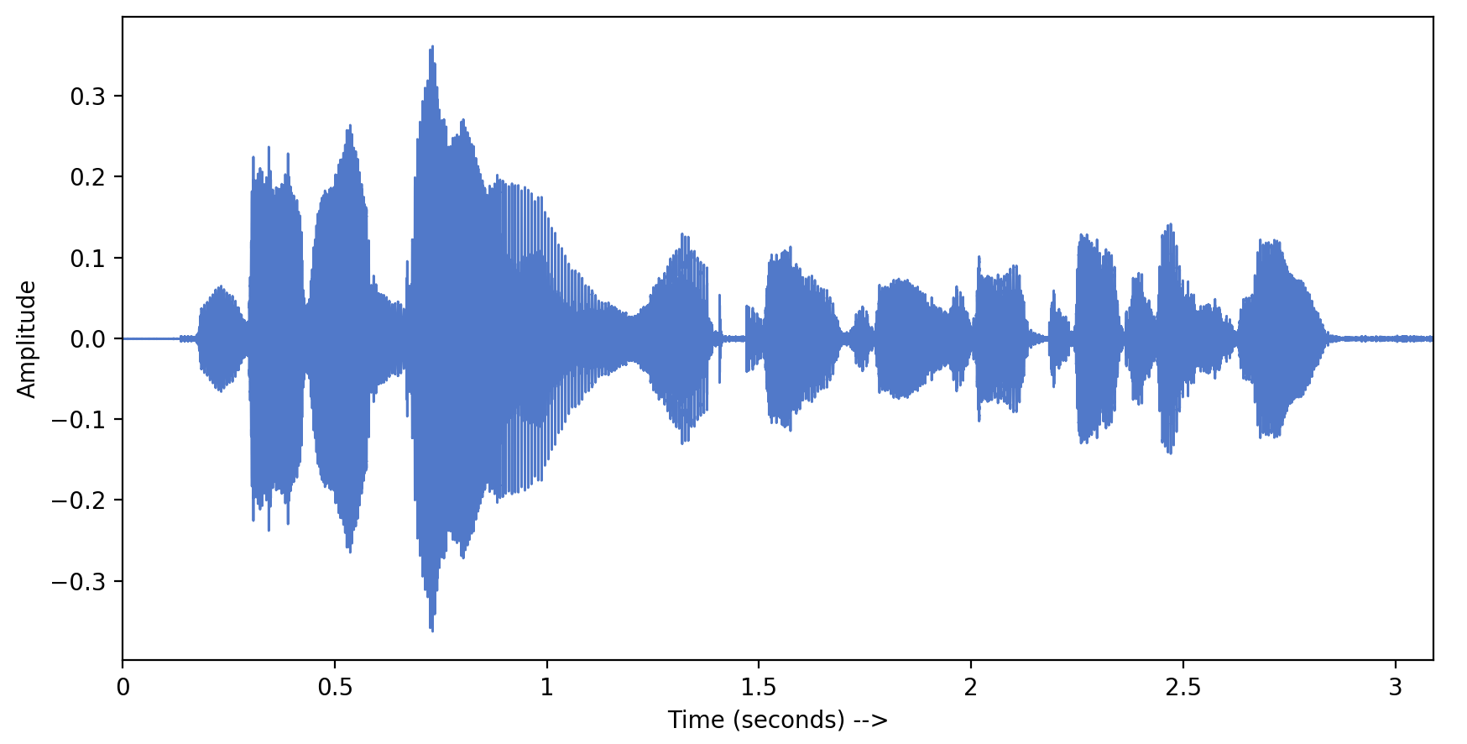
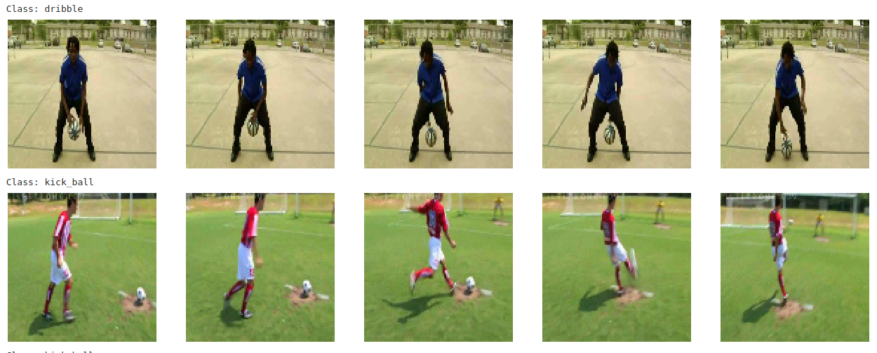
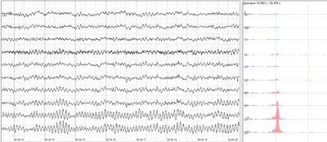
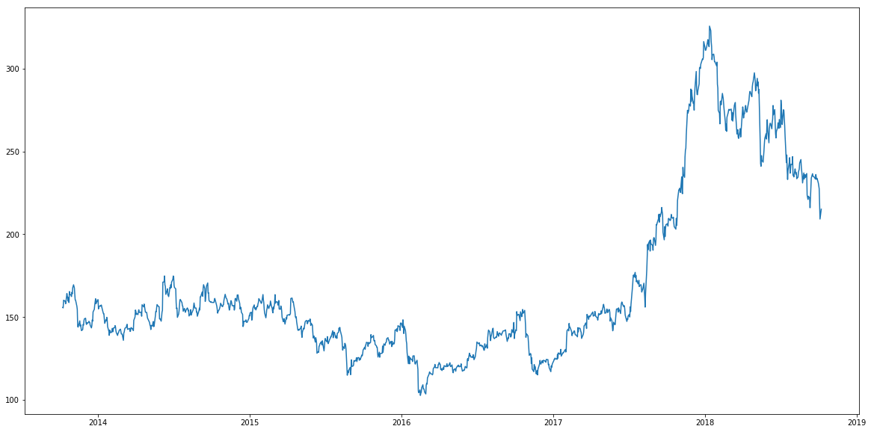
Recurrent Neural Networks
Many real-life data are sequences (e.g., time series):
Audio
Video
…………
EEG Brain signals
Stock Price Prediction

Slide 6
Recurrent Neural Networks
In the last lecture, we have seen that we can process sequences with convolutional neural networks:
z₃
Layer 3
z₂
CNNs, however, are designed to capture local dependencies (i.e., the ones available in the receptive field).
Layer 2
Input
Sequence axis (e.g., time)
For some types of signals, we want to learn long-term dependencies.
For instance, we might want to have a model whose neurons depend on the full history (i.e., all the past elements).

Slide 7
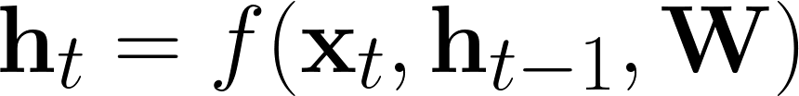
Recurrent Neural Networks
In Recurrent Neural Networks (RNNs), the current output depends on all the previous inputs.
The general form for an RNN is the following:
The current state h_{t} depends on:
The current input x_{t}
The previous state h_{t}
A set of learnable parameters W

Slide 8
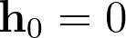
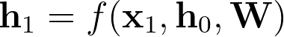
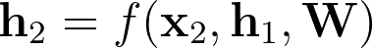
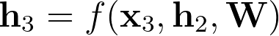
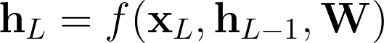
Recurrent Neural Networks
We can unfold the recurrent neural networks in this way:
h1
h2
h3
hL-1
h0
f(W)
f(W)
f(W)
…..
f(W)
hL
x1
x2
x3
xL
The current state ht depends on the current input xt and all the previous ones.
The final state hL depends on all the inputs.

Slide 9
Recurrent Neural Networks
h1
h2
h3
hL-1
h0
f(W)
f(W)
f(W)
…..
f(W)
hL
x1
x2
x3
xL
We apply the same neural network f for all the sequence steps (weight sharing).
As seen for CNNs, applying the same weights over the input helps find patterns in the data.
In CNNs, we share the same filter over the inputs, for RNNs we share a full neural network.
Moreover, RNNs we can find arbitrary long patterns because the state vector acts as a memory of the previous inputs.

Slide 10
Recurrent Neural Networks
h1
h2
h3
hL-1
h0
f(W)
f(W)
f(W)
…..
f(W)
hL
x1
x2
x3
xL
Once unfolded, RNN can be represented as a single big computational graph.
We can see a recurrent neural network as a deep neural network, which is deep in the time axis.
RNNs can be used for different types of problems, that include:
Problems where we need a prediction at each time step (Many-to-many).
Problems where we need a single prediction at the end (Many-to-one).
Problems where we want to turn the input sequence of length T into an output sequence of length S (Seq-to-seq).

Slide 11
Many-to-Many Problems
Labels
When we need a single prediction at each time step (many-to-many problem), we have to:
y1
y2
y3
yL
L
L
L
L
predictions
Apply a final transformation (e.g., linear model) on top of each hidden state.
f(V)
f(V)
f(V)
f(V)
Apply a loss function at each time step (e.g., Categorical Cross-Entropy for multi-class classification, MSE for regression).
h1
h2
h3
hL
h1
h2
h3
hL-1
h0
f(W)
f(W)
f(W)
…..
f(W)
hL
The total loss will be the sum (or average) of all the losses at each time step.
x1
x2
x3
xL

Slide 12

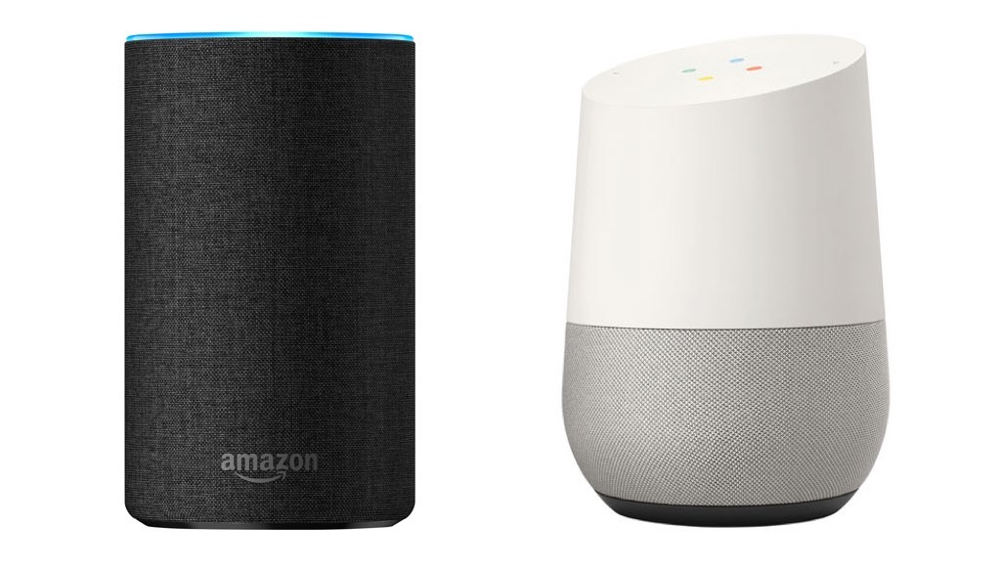
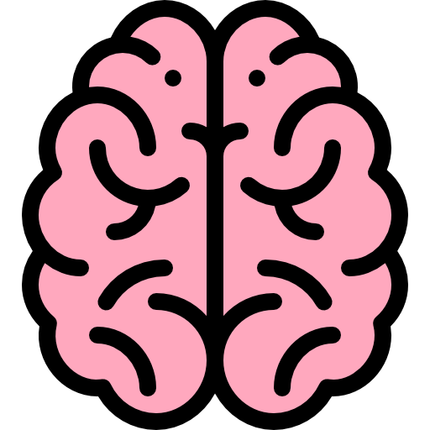

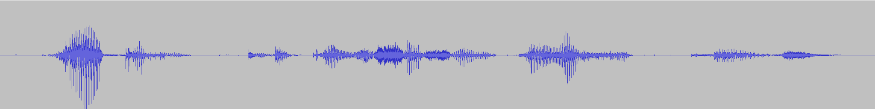
Many-to-Many Problems
Can you identify some modules that need to solve a “many-to-many” problem?
0
1
0
Acoustic Environment
Recording Setup
Voice Activity Detection
Speech
Enhancement
Keyword Spotting
RNN
RNN
RNN
Speech Recognition
feat1
feat2
feat3
Acoustic Environment
Generation Setup
Speech Synthesis
Dialogue
Spoken Language Understanding
Feature Extraction
In Voice Activity Detection, at each time step (i.e., for each input feature) we need to output “0” (non-speech) or “1” (speech).
Keyword Spotting is another example.

Slide 13
Many-to-Many Problems
Can you identify other modules that need to solve a “many-to-many” problem?
Acoustic Environment
Recording Setup
Voice Activity Detection
Speech
Enhancement
Keyword Spotting
Speech Recognition
Acoustic Environment
Generation Setup
Speech Synthesis
Dialogue
Spoken Language Understanding
Clean feat1
Clean feat2
Clean feat3
In speech enhancement, we need to output a cleaned version of the input signal.
RNN
RNN
RNN
…..
Noisy feat1
Noisy feat2
Noisy feat3

Slide 14
Many-to-Many Problems
Another example is language modeling, where we want to predict the next word given the previous ones.
How
Are
????
RNN
RNN
RNN
Hello
How
Are
Language models are used in many parts of a conversational AI pipeline.
For instance, are used in speech recognition to help a speech recognizer privilege sequence of words that are more likely than others.

Slide 15
Many-to-one Problems
h1
h2
h3
hL-1
h0
f(W)
f(W)
f(W)
…..
f(W)
hL
f(V)
L
y1
x1
x2
x3
xL
When we need a single prediction in output (many-to-one problem), we can do the following:
Apply a final transformation (e.g., linear model) on top of the last hidden state (which depends on all the inputs).
As an alternative, you can average all the hidden states.
Finally, you have to apply a loss function on top of it (e.g., Categorical Cross-Entropy for multi-class classification, MSE for regression).

Slide 16
Many-to-one Problems
In a conversational AI pipeline, we have a many-to-one problem when we can “listen” all the input signal and classify it only after that.
An example is speaker identification.
Other examples are:
Emotion Recognition
Language Recognition
Accent Recognition
Classifier
spk1
RNN
RNN
…..
RNN
spk2
…..
spkN
feat1
feat2
featT
Feature Extraction

Slide 17
Sequence-to-Sequence Problems
RNNs can also be used for sequence-to-sequence problems:
We employ an RNN-based encoder that encodes all the L inputs.
y1
y2
yD
Labels
We employ an RNN-based decoder that takes one of many encoded states and generates (one by one) the output elements.
L
L
L
Predictions
A loss is computed on top of each prediction.
f(V)
f(V)
f(V)
d1
d2
dD
h1
hL-1
d1
dS-1
h0
e(W)
e(W)
…..
e(W)
hL
d(W)
d(W)
…..
d(W)
x1
x2
xL

Slide 18
Sequence-to-Sequence Problems
Examples of sequence-to-sequence problems are:
Speech Recognition
word1
word2
wordN
RNN
RNN
…..
RNN
RNN
RNN
…..
RNN
feat1
feat2
featT
Feature Extraction

Slide 19
Sequence-to-Sequence Problems
Examples of sequence-to-sequence problems are:
Machine Translation
J’
aime
les
chats
RNN
RNN
RNN
RNN
RNN
RNN
RNN
Emb
Emb
Emb
I
love
cats

Slide 20
Sequence-to-Sequence Problems
Examples of sequence-to-sequence problems are:
Dialogue
I
lost
my
card
RNN
RNN
RNN
RNN
RNN
RNN
RNN
RNN
RNN
……
Emb
Emb
Emb
Emb
Emb
How
May
I
help
you?

Slide 21
Training RNNs

Slide 22
Training
How can we train an RNN?
After unfolding it, the RNN becomes a standard computational graph that employs long chains of computations.
y1
y2
y3
yL
L
L
L
L
We can thus compute the gradient with the backpropagation algorithm.
f(V)
f(V)
f(V)
f(V)
To highlight that the gradient is mainly propagated over time, it is sometimes called backpropagation through time.
h1
h2
h3
hL
h1
h2
h3
hL-1
h0
f(W)
f(W)
f(W)
…..
f(W)
hL
Once we have the gradient, we can update the parameters with gradient descent (and all its variants seen so far).
x1
x2
x3
xL

Slide 23
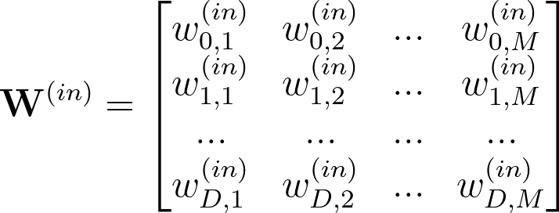
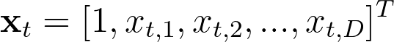
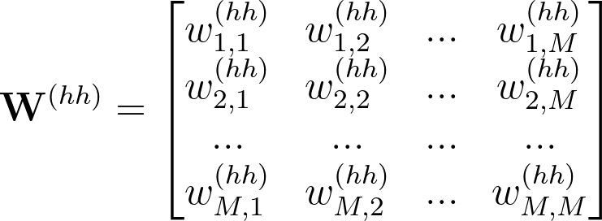
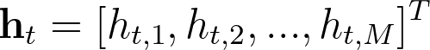
Vanilla RNN
The simplest RNN is called Vanilla RNN (or Elman RNN) is based on the following equation:
We perform a linear transformation of both the current input and the previous state.
We sum them up and apply a non-linearity (Tanh or ReLU).

Slide 24
Vanishing Gradient
When using RNNs, we have to backpropagate the gradient through a long temporal chain.
Gradient backpropagation
h1
h2
hL-1
h0
Dot
Tanh
Dot
Tanh
…..
Dot
Tanh
w^{hh}
+
w^{hh}
+
w^{hh}
+
Dot
Dot
Dot
w^{in}
w^{in}
w^{in}
x1
x2
xL
As we have seen, this might cause exploding gradients or vanishing gradients.
The vanishing gradient problem prevents the model to learn long-term dependencies.

Slide 25
Vanishing Gradient
As we have seen in the previous lecture, we can add shortcuts in the architecture to fight vanishing gradients.
h1
h2
hL-1
h0
Dot
Tanh
Dot
Tanh
…..
Dot
Tanh
w^{hh}
+
w^{hh}
+
w^{hh}
+
Dot
Dot
Dot
w^{in}
w^{in}
w^{in}
x1
x2
xL
In this case, we can consider shortcuts across time steps.

Slide 26

Vanishing Gradient
Instead of hard-coding pre-defined shortcuts, why don’t we try to learn them?
shortcut
Can we make shortcuts learnable?
shortcut
h1
h2
hL-1
h0
Dot
Tanh
Dot
Tanh
…..
Dot
Tanh
w^{hh}
+
w^{hh}
+
w^{hh}
+
Dot
Dot
Dot
Goal: Remembering information for long periods of time.
w^{in}
w^{in}
w^{in}
x1
x2
xL
Ideally, we want to learn “dynamic” shortcuts that connect relevant time steps.

Slide 27
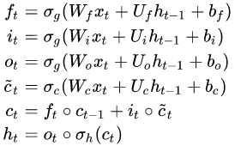
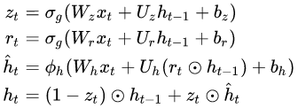
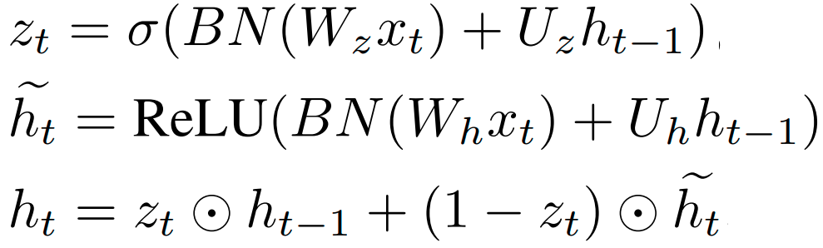
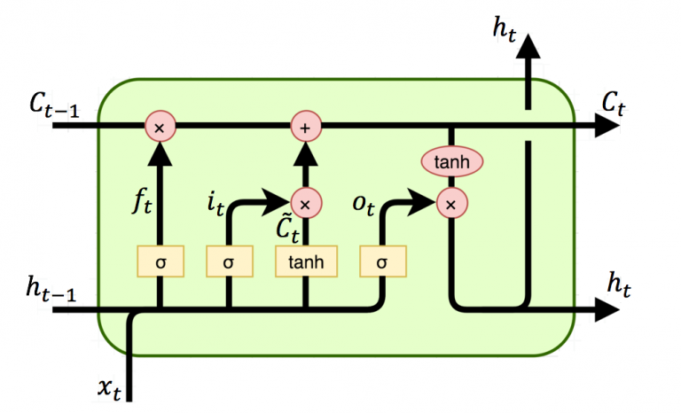
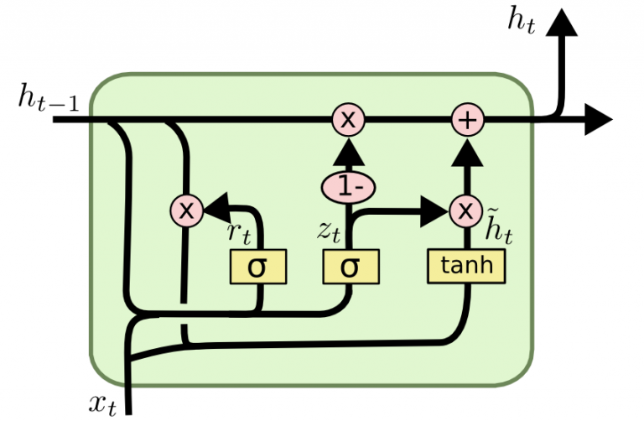
Gated RNNs
This is exactly what we are trying to do with multiplicative gates:
Long Short-Term Memory (LSTM)
Gated Recurrent Units (GRU)
Light Gated Recurrent Units (Li-GRU)
If the update gate z is 1, we can remember forever the state h (thus learning arbitrary long-term dependencies)
3 multiplicative gates
2 multiplicative gates
1 multiplicative gate

Slide 28
LSTM
LSTM manages the flow of information using three multiplicative gates (called input, output, and forget gates).
The cell state is the memory vector.
It’s very easy for information to just flow along it unchanged.
To remember the past cell state, we just need to set the forget to one and the input gate to zero.
Multiplicative Gates
Cell
state
This implements the “shortcut” as we can skip time steps and store information for an arbitrarily large number of steps.
Hochreiter & Schmidhuber (1995)
https://www.bioinf.jku.at/publications/older/2604.pdf

Slide 29
LSTM
More specifically, the role of the gates is the following:
Input Gate: It decides what new information we’re going to store in the cell state.
The outcome is a vector containing numbers between 0 and 1 (due to the sigmoid activation):
“0” means“ do not store the content of the current input”.
“1” means“ store the content of the current input unchanged”.

Slide 30
LSTM
Forget Gate: It decides how much information keep from the previous cell state.
“0” means“ totally forget the past.
“1” means” keep the past information unchanged.
Output Gate: It decides how much information from the cell stare expose in the output
“0” means“ do not expose the cell state
“1” means” expose the full cell state

Slide 31
GRU
https://arxiv.org/pdf/1412.3555)
In the last few years, we have seen a trend toward simplifying LSTMs.
Very often we don’t need all the complexity and flexibility provided by LSTMs.
A notable example is the Gated Recurrent Units (GRUs).
It only used 2 multiplicative gates.
Reset Gate: It decides how much past information to forget
Update Gate: It decides how much past information to store for future usage.
There is no output gate and cell state.
The performance is similar to LSTM in many tasks.

Slide 32
Light-GRU
https://arxiv.org/abs/1803.10225
A further simplification is the Light Gated Recurrent Unit (Li-GRU)
It only used 1 multiplicative gate only:
Update Gate: It decides how much information from the past to use for the current prediction and store for the future one
There are other improvements: ReLU + Batchnorm is used
Li-GRU has been shown to be faster and perform better than GRU in speech processing tasks

Slide 33
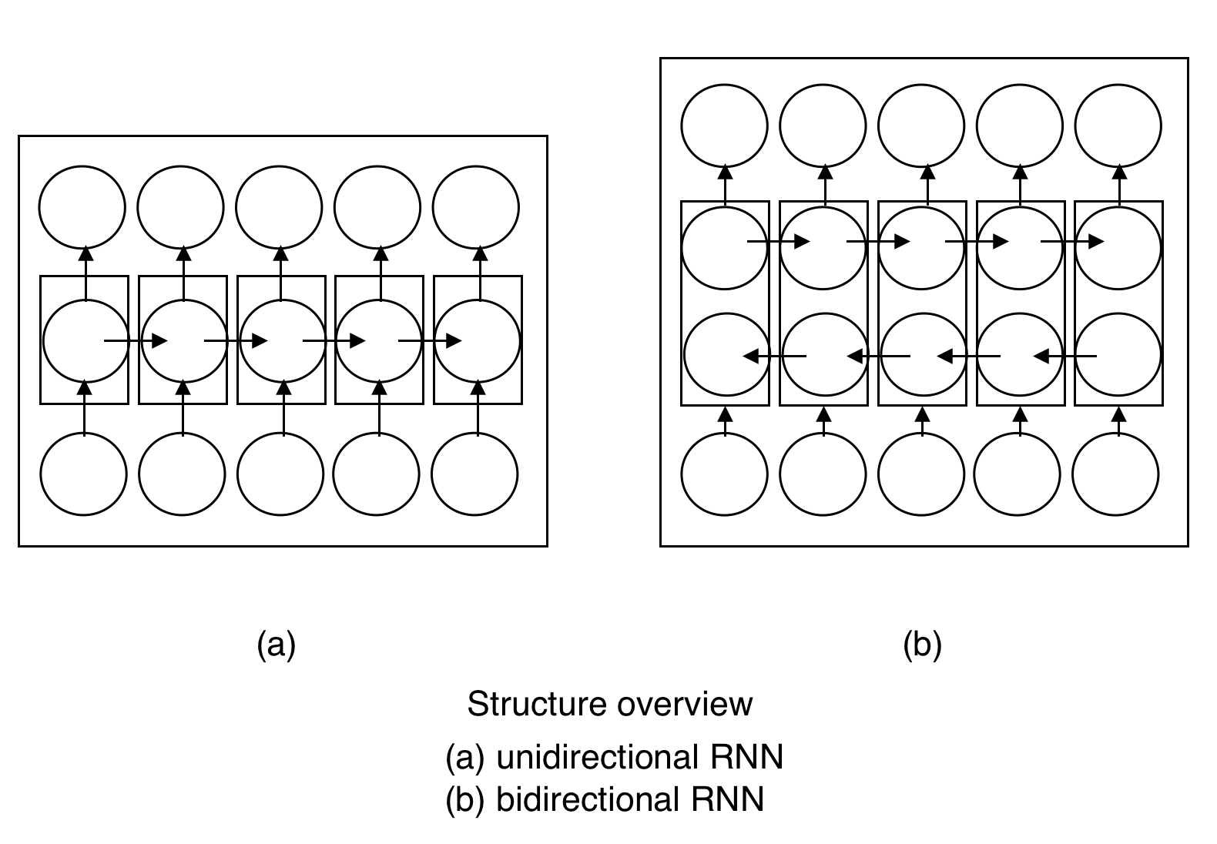
Bidirectional RNN
In some cases, we want to make a prediction at each time step based on the whole input elements and not only the previous ones.
We can employ two RNNs running in opposite directions.
These RNNs use different parameters or share them.
At each layer, we can combine the forward and the backward state by concatenating them or summing them up.
Examples of applications are speech recognition, machine translation, and handwritten recognition.

Slide 34
CNNs + RNNs + MLPs
We can make RNNs even deeper by stacking multiple RNN layers.
We can also combine CNNs, RNNs, and DNNs (MLPs):
Prediction
This model is called CRDNN and is very powerful:
DNN
It first learns local contexts with a CNN.
It then captures long-term dependencies with an RNN.
RNN
Finally, it performs a final classification with an MLP.
CNN
All the blocks can be jointly trained.
x
This is one of the models used in SpeechBrain to process speech signals.

Slide 35
Variable-Length Sequences
Often, the sequences in input to the RNN have different lengths.
For instance, think about a speech signal: in some cases, we might have long recordings, while in others short ones.
How can we manage variable-length sequences?
We can handle it by zero-padding: within each minibatch, we pad with zeros the inputs to match the length of the longest one.
00000000000000000000000
If the length of the inputs is very different, this is computationally inefficient because we waste time processing zeros.
Minibatch
0000000000000000000

Slide 36
Variable-Length Sequences
One way to mitigate this issue is to sort the inputs by length (in ascending or descending order) before creating the minibatches.
This minimizes the need for zero-padding, but sacrifices randomness in the minibatch creation:
since we sorted the data, minibatches composed of the same data are shown across epochs.
000000
Minibatch
000
A compromise solution can be implemented through bucketing:
We split data into buckets such that each bucket contains inputs of similar lengths.
When creating minibatches, we sample random inputs from the same bucket.

Slide 37
Sequence-to-Sequence Learning
With RNNs

Slide 38
Sequence-to-Sequence Learning with RNNs
The goal of sequence-to-sequence learning is to map an input sequence with T elements into an output sequence with L elements.
Speech Recognition and Machine Translation are examples of seq2seq learning tasks:
Seq2Seq
Model
“J’”, “aime”, “les”, “chats”
For machine translation, the input is a sequence of embeddings (i.e, we typically assign a continuous vector to each input token)
“I”, “love”, “cats”
Seq2Seq
Model
“I”, “love”, “cats”
For speech recognition, the input is a sequence of features.
Features

Slide 39
Sequence-to-Sequence Learning with RNNs
Encoder-Decoder architecture offers a natural way to address sequence-to-sequence learning
Input
Sequence
Encoder
Decoder
Output
Sequence
The encoder takes in input a sequence and turns it into a sequence of latent representations.
The decoder processes these latent representations to derive the output sequence.
RNN-based
Encoder-Decoder Models
Transformer-based

Slide 40

Sequence-to-Sequence Learning with RNNs
A simple way to use RNNs for sequence-to-sequence learning is the following:
“J”
“aime”
“les”
“chats”
<eos>
Softmax
Softmax
Softmax
Softmax
Softmax
Encoder
Linear
Linear
Linear
Linear
Linear
RNN
h1
RNN
h2
RNN
h3
RNN
z1
RNN
z2
RNN
z3
RNN
z4
RNN
Decoder
Emb
Emb
Emb
“I”
“Iove”
“cats”
The decoder is fed by the last encoded state.
The last encoded state depends on all the inputs

Slide 41
Sequence-to-Sequence Learning with RNNs
A simple way to use RNNs for sequence-to-sequence learning is the following:
“J”
“aime”
“les”
“chats”
<eos>
Softmax
Softmax
Softmax
Softmax
Softmax
Encoder
Linear
Linear
Linear
Linear
Linear
RNN
h1
RNN
h2
RNN
h3
RNN
z1
RNN
z2
RNN
z3
RNN
z4
RNN
Decoder
Emb
Emb
Emb
We need a special token to signal the end-of-sentence <eos>
“I”
“Iove”
“cats”
In some application, such as speech recognition or machine translation, you don’t know how long is the output sequence. At inference time, you need to stop decoding when the model outputs <eos>.

Slide 42

Sequence-to-Sequence Learning with RNNs
This simple model does not work well in practice.
“J”
“aime”
“les”
“chats”
<eos>
Softmax
Softmax
Softmax
Softmax
Softmax
Encoder
Linear
Linear
Linear
Linear
Linear
RNN
h1
RNN
h2
RNN
h3
RNN
z1
RNN
z2
RNN
z3
RNN
z4
RNN
Decoder
Emb
Emb
Emb
“I”
“Iove”
“cats”
What is missing?

Slide 43
Sequence-to-Sequence Learning with RNNs
This simple model does not work well in practice.
“J”
“aime”
“les”
“chats”
<eos>
Softmax
Softmax
Softmax
Softmax
Softmax
Encoder
Linear
Linear
Linear
Linear
Linear
RNN
h1
RNN
h2
RNN
h3
RNN
z1
RNN
z2
RNN
z3
RNN
z4
RNN
Decoder
Emb
Emb
Emb
We fed into the decoder only the last hidden state hT.
In “theory” this summarizes the information of all the time steps.
“I”
“Iove”
“cats”
In “practice” the information about the first elements of the sequence depends more strongly on the most recent elements. We may have forgotten the first elements of the sequence.

Slide 44

Sequence-to-Sequence Learning with RNNs
This simple model does not work well in practice.
“J”
“aime”
“les”
“chats”
<eos>
Softmax
Softmax
Softmax
Softmax
Softmax
Encoder
Linear
Linear
Linear
Linear
Linear
RNN
h1
RNN
h2
RNN
h3
RNN
z1
RNN
z2
RNN
z3
RNN
z4
RNN
Decoder
Emb
Emb
Emb
“I”
“Iove”
“cats”
How can we fix that?

Slide 45


Sequence-to-Sequence Learning with RNNs
“J”
“aime”
“les”
“chats”
<eos>
Softmax
Softmax
Softmax
Softmax
Softmax
Encoder
Linear
Linear
Linear
Linear
Linear
RNN
h1
RNN
h2
RNN
h3
z0
RNN
z1
RNN
z2
RNN
z3
RNN
z4
RNN
Emb
Emb
Emb
h1
h1
h1
h1
h1
h2
h2
h2
h2
h2
“I”
“Iove”
“cats”
h3
h3
h3
h3
h3
What about concatenating all the encoded states and feeding them into the decoder RNNs in all steps?
Different inputs might have different lengths, causing the number of encoded states to fluctuate.
However, the decoder requires inputs with a fixed dimensionality.

Slide 46
Sequence-to-Sequence Learning with RNNs
“J”
“aime”
“les”
“chats”
<eos>
Softmax
Softmax
Softmax
Softmax
Softmax
Encoder
Linear
Linear
Linear
Linear
Linear
RNN
h1
RNN
h2
RNN
h3
z0
RNN
z1
RNN
z2
RNN
z3
RNN
z4
RNN
Emb
Emb
Emb
h1
h1
h1
h1
h1
+h2
+h2
+h2
+h2
+h2
“I”
“Iove”
“cats”
+
+
+
+
+
h3
h3
h3
h3
h3
What about summing up all the encoded states and feeding them into the decoder RNNs in all steps?
In this case, the tensor in input to the decoder has a fixed dimensionality.
But..
A plain summation dilutes the information carried by the inputs. We likely lose important details needed to perform an accurate translation.

Slide 47

Sequence-to-Sequence Learning with RNNs
“J”
“aime”
“les”
“chats”
<eos>
Softmax
Softmax
Softmax
Softmax
Softmax
Encoder
Linear
Linear
Linear
Linear
Linear
RNN
h1
RNN
h2
RNN
h3
z0
RNN
z1
RNN
z2
RNN
z3
RNN
z4
RNN
a1,1
a2,1
a3,1
a4,1
a5,1
Emb
Emb
Emb
h1
h1
h1
h1
h1
+h2
+h2
+h2
+h2
+h2
a1,2
a2,2
a3,2
a4,2
a5,2
“I”
“Iove”
“cats”
+
+
+
+
+
a1,3
a2,3
a3,3
a4,3
a5,3
h3
h3
h3
h3
h3
What about doing a weighted average of all the encoded states and feeding them into the decoder RNNs in all steps?
We want the decoder to use the information on a subset of inputs only.
This can make sense only if we assign different weights at each decoding stage.

Slide 48
Sequence-to-Sequence Learning with RNNs
“J”
“aime”
“les”
“chats”
<eos>
Softmax
Softmax
Softmax
Softmax
Softmax
Encoder
Linear
Linear
Linear
Linear
Linear
RNN
h1
RNN
h2
RNN
h3
z0
RNN
z1
RNN
z2
RNN
z3
RNN
z4
RNN
a1,1
a2,1
a3,1
a4,1
a5,1
Emb
Emb
Emb
h1
h1
h1
h1
h1
+h2
+h2
+h2
+h2
+h2
a1,2
a2,2
a3,2
a4,2
a5,2
“I”
“Iove”
“cats”
+
+
+
+
+
a1,3
a2,3
a3,3
a4,3
a5,3
h3
h3
h3
h3
h3
The weights assigned to each encoded state are called attention weights.
Attention to “I”
Attention to “Iove”
Attention to “Iove” and “cats”
Attention to “cats”

Slide 49
Sequence-to-Sequence Learning with RNNs
How can we learn attention weights?
We can use a neural network (e.g., a simple MLP)
Decoding Step 1
Decoding Step 2
“J”
z0
So
f
tmax
0.9
“aime”
z1
So
f
tmax
0.2
MLP
a1,1
MLP
a2,1
“I”
h1
“I”
h1
“J”
z0
0.1
“aime”
z1
0.7
MLP
a1,2
MLP
a2,2
“love”
h2
“love”
h2
“J”
z0
0.0
“aime”
z1
0.1
MLP
a1,2
MLP
a2,2
“Cats”
h3
“Cats”
h3
We repeat this operation for all the decoding steps.
We apply a softmax to make sure the weights are between 0 and 1 (and they sum up to one).
The Attention MLP is jointly trained with the encoder and decoder RNNs.

Slide 50
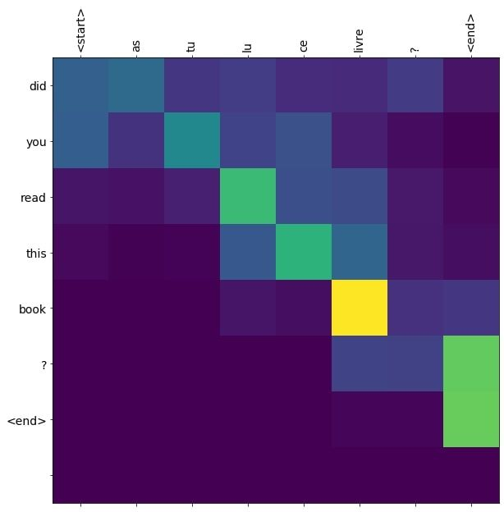


Sequence-to-Sequence Learning with RNNs
The attention mechanism learns a soft alignment between the input and output sequences
The attention weights are not necessarily diagonal!
Attention mechanisms were “invented” at Mila in 2015 by D.Bahdanau.
https://arxiv.org/abs/1409.0473

Slide 51
Sequence-to-Sequence Learning with RNNs
The attention mechanism introduces dynamic shortcuts that connect encoder and decoder states.
“J”
“aime”
“les”
“chats”
<eos>
a1,1
+
a1,2
Softmax
Softmax
Softmax
Softmax
Softmax
a1,3
Linear
Linear
Linear
Linear
Linear
RNN
RNN
RNN
z0
RNN
z1
RNN
z2
RNN
z3
RNN
z4
RNN
h1
h2
h3
Emb
Emb
Emb
“I”
“Iove”
“cats”
This makes it easier for the gradient to flow from the decoder to the encoder.
“Shortcuts” is all you need!

Slide 52
Sequence-to-Sequence Learning with RNNs
Often, the decoder is autoregressive (the previous prediction is fed into the decoder)
“J”
“aime”
“les”
“chats”
<eos>
a1,1
+
a1,2
Softmax
Softmax
Softmax
Softmax
Softmax
a1,3
Linear
Linear
Linear
Linear
Linear
RNN
RNN
RNN
z0
RNN
z1
RNN
z2
RNN
z3
RNN
z4
RNN
h1
h2
h3
Emb
Emb
Emb
Emb
Emb
Emb
Emb
Emb
“I”
“Iove”
“cats”
The “begin of sentence”
special token is used at the first decoding step.
<bos>
“J”
“aime”
“les”
“chats”
This is not strictly needed for RNNs (as the decoding state heavily depends on the previous prediction).
In practice, however, it often improves performance.

Slide 53
Sequence-to-Sequence Learning with RNNs
Another way to improve the performance is to stack multiple RNNs.
“J”
“aime”
“les”
“chats”
<eos>
Softmax
Softmax
Softmax
Softmax
Softmax
+
Linear
Linear
Linear
Linear
Linear
RNN
RNN
RNN
RNN
RNN
RNN
RNN
RNN
RNN
RNN
RNN
RNN
RNN
RNN
RNN
RNN
Emb
Emb
Emb
Emb
Emb
Emb
Emb
Emb
“I”
“Iove”
“cats”
<bos>
“J”
“aime”
“les”
“chats”
Normally, we run the attention mechanism on top of the last encoder/decoder layers only.
a1,1
a1,2
a1,2

Slide 54
Sequence-to-Sequence Learning with RNNs
Another improvement is location-aware attention.
z2
MLP
So
f
tmax
a3,1
0.1
h1
z2
So
f
tmax
0.1
MLP
a3,1
a2,1
h1
z2
z2
MLP
a3,2
0.8
MLP
a3,2
0.8
h2
h2
z2
0.1
a2,2
MLP
a3,2
h3
z2
MLP
a3,2
0.1
h2
Content-based attention
a2,3
Location-aware attention
We can estimate the current attention weight ai, t not only based on the h (content-based attention) but also based on the previous attention weight ai, t-1 (location-aware attention).
a1,1
a1,2
a1,2

Slide 55
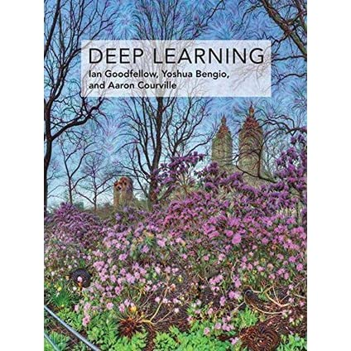


Additional Material
Chapter 2: Linear Algebra
Chapter 3: Probability and information theory
Chapter 5: Machine Learning Basics
Chapter 6: Deep Feedforward Networks
Chapter 9: Convolutional Networks
Chapter 10: Sequence Modeling
During the weekly lab session, we will do:
Tutorial on Seq2Seq Learning with RNNs
Recurrent Neural Networks
Deadline: February, 13 11.59 pm

